Slide 1
Overcoming barriers to HIV testing among young MSM and transgender women in Jamaica
Carmen Logie, PhD
Canada Research Chair in Global Health Equity & Social Justice with Marginalized Populations
Associate Professor, Factor-Inwentash Faculty of Social Work, University of Toronto, Canada
@carmenlogie
Share your thoughts on this presentation with #IAS2019

Slide 2

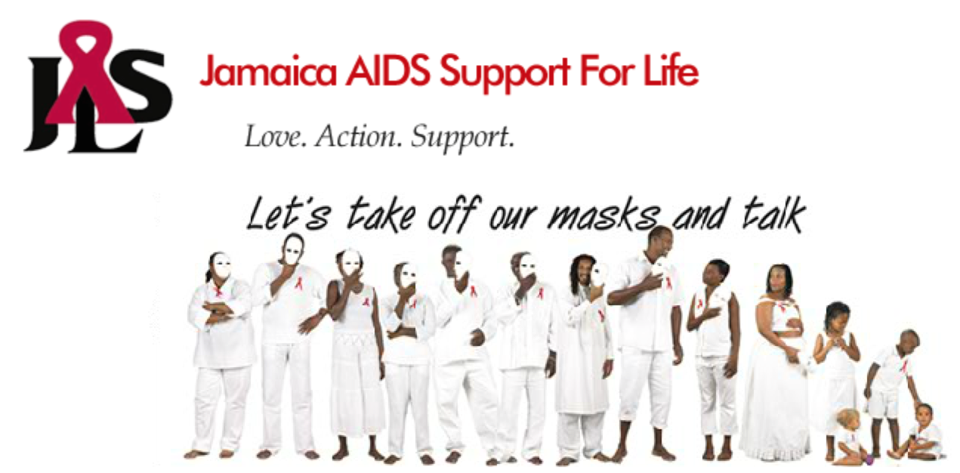

Slide 3
HIV in Jamaica
AIDS is Jamaica's leading cause of death for persons aged 18-49
  The Caribbean is the global region most impacted by HIV following Sub-Saharan Africa
Gay and bisexual men are overrepresented in new HIV infections globally, and in Jamaica their HIV prevalence is estimated at 32.8%
  Caribbean's highest and 19-fold higher than general population prevalence (1.7%)
Trans women are also overrepresented in the global HIV epidemic: our study identified a prevalence of 25.2%
Jamaica is one of 70 countries in which same-sex sexual practices are criminalised

Slide 4
Mixed-methods study
In-depth interviews with persons aged 18-29
  20 MSM (mean age 22.2; 60% gay, 30% bisexual, 10% pansexual)
  20 trans women (mean age 23.3; 65% gay, 35% heterosexual)
Focus groups with persons aged 18-29:
  1 with MSM (n=10; 8 gay identified, 2 pansexual)
  1 with trans women (n=8; 4 gay identified and 4 heterosexual)
Key informant interviews (n=13)
Cross-sectional tablet-based survey with peer driven sampling
  MSM (n=556, median: 24, IQR: 22-28), trans women (n=130, median: 24, range: 16-44)

Slide 5
Qualitative findings

Slide 6
HIV testing barriers
Health care mistreatment
Confidentiality concerns
HIV stigma rooted in low treatment literacy

Slide 7
Healthcare mistreatment
“Sometimes, when you go to the clinic and you find out that you are positive, they will look on you ‘a way.’ They may say, “He’s so young, how ‘im [does he] manage to be HIV?” Also, if you are gay, you can’t let them know you are gay, if you are a transsexual, you can’t let them know that either”. (T008)
“The nurse who attended to him told him that he had ‘gone bad’ again because he first has HIV and now he has an STI. The nurse also told him that he was not living any life, that he was evil, wicked and was killing off other people. So, he was not going back”. (KI 1)

Slide 8
Confidentiality issues
“In terms of being fearful, it’s the confidentiality thing. When you go to clinic or other places, sometimes you go to the doctor and then when you come out everybody knows your business. So, that’s a big thing in terms of going to get an HIV test, people are going to be afraid that confidentiality is not upheld”. (focus group discussion MSM)
“I seek sexual healthcare from clinics that is not of LGBT groups, a clinic where ‘normal’ people go to.” (T012)
“If you go to a place where gays work, you might worry at times that they’ll bring out your results to people on the street to other friends” (T003).

Slide 9
HIV-related stigma
“There is still a stigma attached that if you have it yuh jus a go dead [you will just die]. Just knowing is still difficult.” (MSM FGD)
“The stigma that’s attached to being positive is that your life will end. So you need something to say to those people other than ‘there are persons you can talk to.’” (M001)
“You and your partner, no matter how you love each other once you go to do a test and it comes
back positive the love isn’t there anymore. The love will drop and nobody wants that and there’s
the risk that they might tell other persons about you and that’s not nice”. (MSM FGD)
Notes:
Low treatment literacy, fear of losing partners and friends (anticipated stigma)

Slide 10
HIV testing facilitators
Improving access
Social Support
Benefits of knowing one's status

Slide 11
Improve access
“Availability, cause I’m not gonna go 10 miles to get that [HIV test] done. Luckily a lot of places does testing for free and that helps.” (M012)
“We have a clinic here on campus, where mainly every two weeks I would text the guys and say ‘guys, let us meet on this day we are going to the clinic to get a checkup.” (M003)
“When I see one of those buses around the place at health fairs, I do it then. I take that opportunity. … I can’t tell the last time I went to the doctor. I don’t go to the doctor to get
tested …That privacy thing doesn’t seem to work with me. I still think I will be judged.” (M001)
“The bus will come to our spot on the road and take HIV tests and give us condoms and stuff like that.” (TG FGD)

Slide 12
Social support
“The second time I got tested, I was nervous. I don’t know why I was so nervous, so I waited till the bus locked up and was almost ready to drive away. The lady said: ‘so you’re not getting tested?’ She said: ‘there’s nothing to worry about man.’ She kinda calmed me down, talked to me in a way that was friendly. She made me feel like there was nothing wrong. Her approach made me feel better.” (M001)
A transgender woman articulated the importance of peer support from transgender friends when accessing HIV testing:
“They are there for you. They don’t laugh at you. They are there to help you, to get you strong, to build and motivate you.” (T019)
“I am going to do it (HIV test) with my partner. We’re going to do it together. I guess that will help to calm my nerves. But I’ve always been anxious to do it.” (M009)
Notes:
Support from counsellors, friends and couples (implications for peer and couples counselling)

Slide 13
Benefits of knowing one’s status
“It’s very important because the sooner that you know that you are infected with any kind of sexual infection, you can get rid of it or get your meds.” (T009)
“Every 3 months I get a test. No matter what, even if you use a condom, the condom can burst and you don’t know your partner’s status. Sometimes you have to go get tested to know your status.” (M010)
“I think that 70% percent of me has safe sex. Within that 30 percent, I can get AIDS and don’t even know it. I will tell you my next HIV result.” (T017)

Slide 14
Reduce multi-level stigma
“What you guys should focus on doing is making testing not so taboo that you would just go and do it. Because it should be something that you do on a regular basis. Try to make it not as scary. It has all sorts of negative connotations and fear attached to it. So you have to limit the fear and eliminate the stigma and get people to want to get tested.” (MSM FGD)
When asked “how can you reduce this risk of HIV among LGBT youth?”, a gay participant (#15) suggested:
“Empowerment, telling persons, having them believe that they are important, that they are contributing to society just as everybody else. Giving them the faith to accept themselves and love themselves and they will make positive choices.”

Slide 15
Quantitative findings

Slide 16
HIV testing among young MSM
Most (90%) reported having ever been tested for HIV
  Of these, 13.8% reported being HIV-positive
  In multivariable analyses, HIV infection was associated with older age, poorer self rated health, lifetime STI history, enacted sexual stigma, having a healthcare provider
Notes:
Need for integrated HIV & Sti testing

Slide 17
STI testing among young MSM
Three-quarters (74.8%) of the 556 participants reported an STI test:
  44% <3 months ago; 32% 3–5 months ago; 13% 6–12 months ago; 10% >12 months ago
  12.1% reported ever receiving an STI diagnosis
Less recent STI testing linked with: sexual stigma & food insecurity
STI diagnosis associated with: HIV positive status, lower social support
Notes:
We did not find HIV seropositivity to be associated with
increased likelihood of STI testing, suggesting that healthcare
providers may aim to improve STI testing rates among MSM by
integrating HIV and STI testing and care, as recommended by
the World Health Organization.

Slide 18
HIV testing among transgender women
Among 137 participants, 75.7% had ever been tested for HIV; among these, 25.2% were HIV-positive
HIV testing (ever) associated with: HIV risk perception, depression, forced sex, lower HIV stigma, perceived transgender stigma
HIV positive status associated with: homelessness, STI history, perceived & enacted trans stigma, forced sex, physical abuse

Slide 20
Syphilis testing among transgender women
Among 137 participants, 83 (60.6%) opted in for syphilis screening
  8 (9.6%) had positive rapid test results
  30.9% (8/26) of HIV-positive trans women also had a positive lifetime syphilis history
Opting in for syphilis screening associated with: HIV positive serostatus, perceived STI risk, incarceration history

Slide 21
Multi-level testing approaches
Structural: Health care access, healthcare training; poverty integration
Clinic: confidentiality concerns, combine HIV & STI testing
Community : reduce HIV stigma, LGBT stigma, violence
Intrapersonal: address treatment literacy; depression, risk perception, histories of violence that could reduce self efficacy
Accessibility:
  Reduce intersectional stigma by healthcare providers
  Flexible modes of delivery (campus, bus, sex work venues)
  Self-testing potential underexplored
Clinic level
  Spatially organized for privacy & confidentiality
  Integrated HIV & STI testing, education and care
Community level:
  Reduce HIV-related & LGBT stigma, including violence
Intrapersonal level:
  Risk perception & treatment literacy, mental health & histories of violence (syndemics)

Slide 22
Acknowledgments
Peer researchers, collaborators, participants
JASL team members: Kandasi Levermore, Nicolette Jones, Tyrone Ellis
Collaborators: Jamaica AIDS Support for Life, JFLAG: Jamaica Forum for Lesbians, All-Sexuals and Gays, Caribbean Vulnerable Communities (CVC), WE-Change, University of the West Indies, Colour Pink, Aphrodite’s Pride, University of the West Indies
Funders: Canadian Institutes of Health Research
Canada Research Chair Program
Ministry of Research & Innovation Early Researcher Award
Contact: carmen.logie@utoronto.ca

